Slide 1
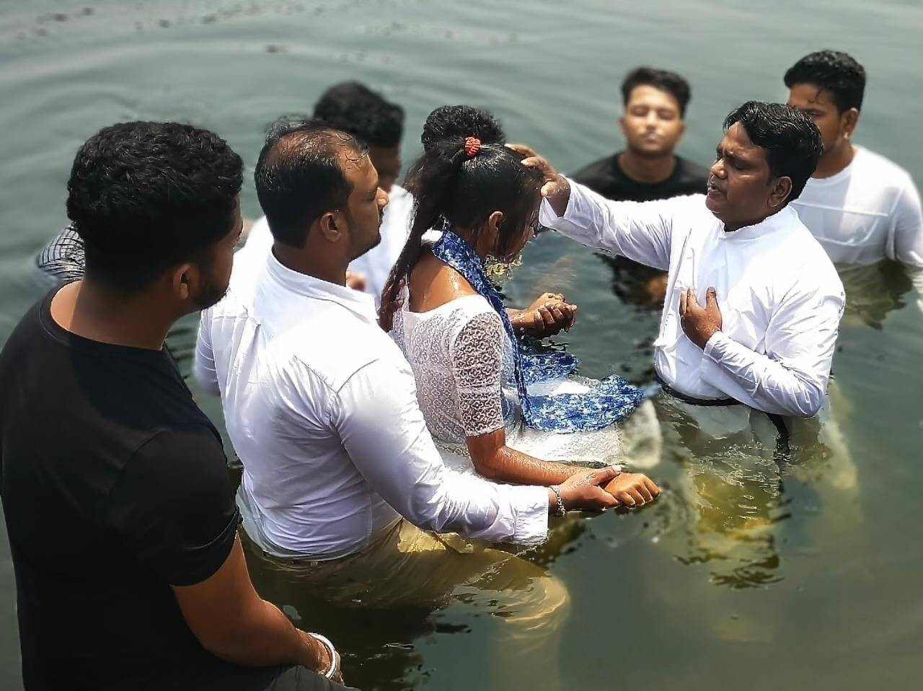

Peter:
From
Failed Disciple
To
Faithful Witness

Slide 2
Week 1: Bearing Witness to People Like You
Acts 2:1-41
I realized that I am a sinner and through the death of Jesus on the cross, the price for my salvation has been paid. Therefore, when the pastor made the altar call, I stepped out with joy and from that moment my life has never been the same.
- Mariatu

Slide 3
Week 1: Bearing Witness to People Like You
Acts 2:1-41
What does the Text Mean?

Slide 4
Week 1: Bearing Witness to People Like You
Acts 2:1-41
What does the Text Mean?
Who Does the Text say We Should Be?

Slide 5
Week 1: Bearing Witness to People Like You
Acts 2:1-41
What does the Text Mean?
Who Does the Text say We Should Be?
How Can We Put this Word of God into Action?

Slide 6
Week 1: Bearing Witness to People Like You
Acts 2:1-41
After listening to the Gospel and watching the movie I felt my life has transformed completely… On that day I decided to serve Jesus and bring many people near to the Lord who are far. From that day to till today I am living my life in the name of Jesus. - Arjun

Slide 7
Peter:
From
Failed Disciple
To
Faithful Witness

