Slide 1
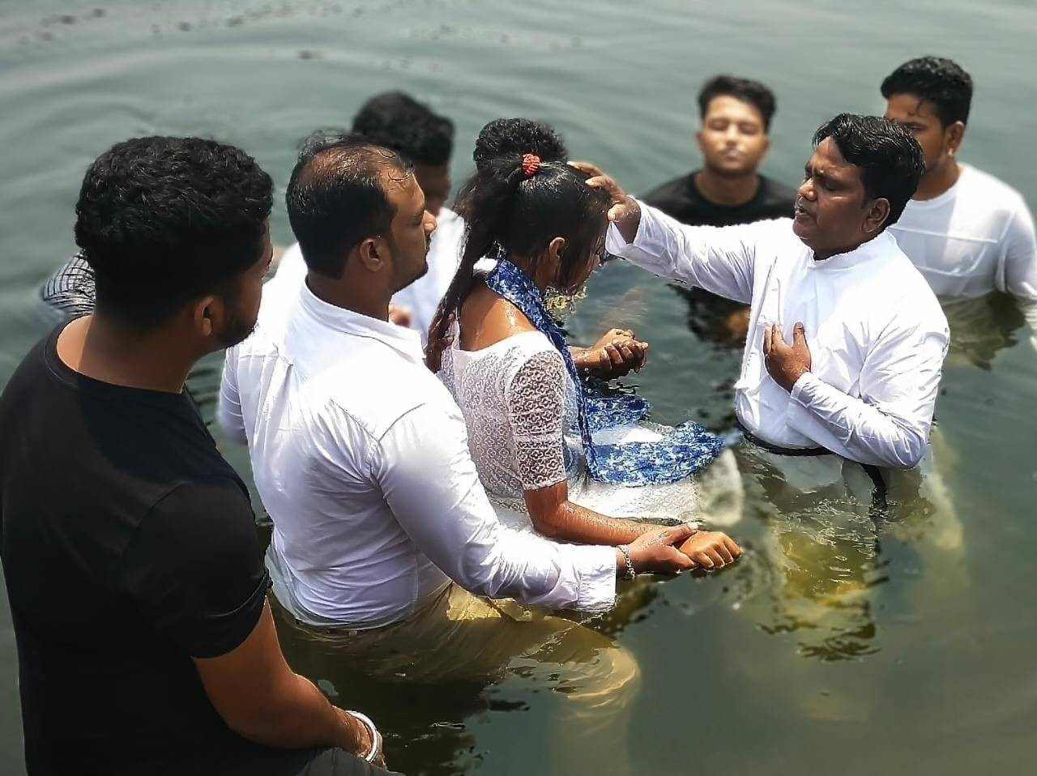

Peter:
From
Failed Disciple
To
Faithful Witness

Slide 2
Week 2: Bearing Witness to People Who Are Against You
Acts 5:12-32
Beloved, my name is Akin, and I was someone who couldn’t forgive and let go of the offense someone purposely did against me. But coming here to watch the JESUS film, I heard Jesus say…
- Akin

Slide 3
Week 2: Bearing Witness to People Who Are Against You
Acts 5:12-32
What does the Text Mean?

Slide 4
Week 2: Bearing Witness to People Who Are Against You
Acts 5:12-32
What does the Text Mean?
Who Does the Text say We Should Be?

Slide 5
Week 2: Bearing Witness to People Who Are Against You
Acts 5:12-32
What does the Text Mean?
Who Does the Text say We Should Be?
How Can We Put this Word of God into Action?

Slide 6
Week 2: Bearing Witness to People Who Are Against You
Acts 5:12-32
I was an enemy of Christians. When those who proclaim the Gospel came to my house, either I kicked them out, or I asked them tough questions that I knew they would never have answers for, and we always ended up in an argument. Then one day… - Kouassi

Slide 7
Peter:
From
Failed Disciple
To
Faithful Witness

