Slide 1
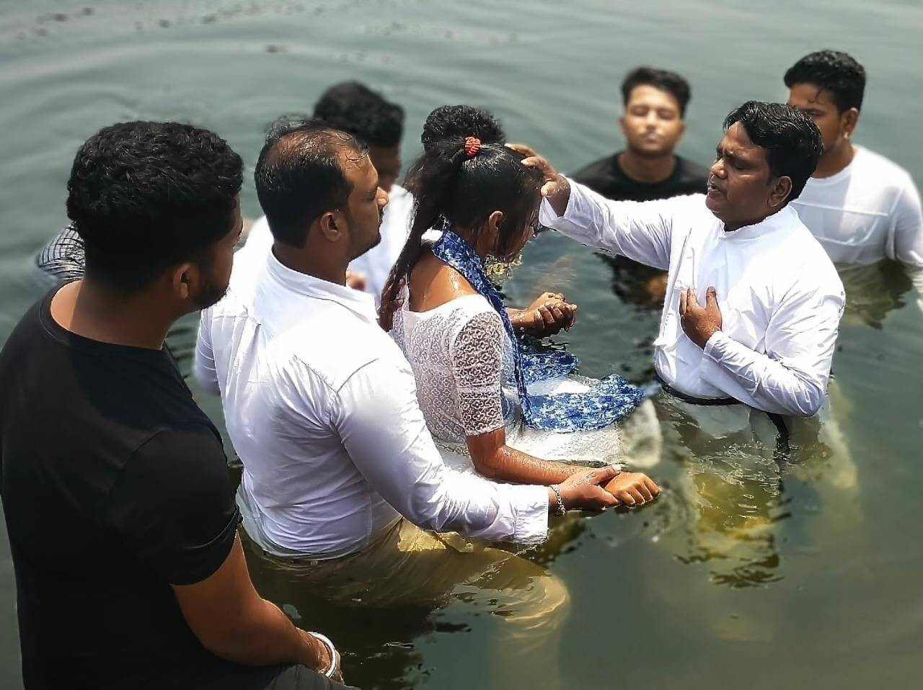

Peter:
From
Failed Disciple
To
Faithful Witness

Slide 2
Week 3: Bearing Witness to People Who Are NOT Like You
Acts 10
During the JESUS film show in a village in Zambia, Dominic the drunkard gave his life to Jesus. Dominic used to drink a lot, and many people did not like him for his uncontrollable behavior.

Slide 3
What does the Text Mean?
Week 3: Bearing Witness to People Who Are NOT Like You
Acts 10

Slide 4
What does the Text Mean?
Who Does the Text say We Should Be?
Week 3: Bearing Witness to People Who Are NOT Like You
Acts 10

Slide 5
What does the Text Mean?
Who Does the Text say We Should Be?
How Can We Put this Word of God into Action?
Week 3: Bearing Witness to People Who Are NOT Like You
Acts 10

Slide 6
I was an enemy of Christians…I will now be a defender of the Word of God. I know that I will be attacked a lot, but I am with Jesus Christ and his servants who will pray for me. Thank you, Lord, for your grace
- Antoine
Week 3: Bearing Witness to People Who Are NOT Like You
Acts 10

Slide 7
Peter:
From
Failed Disciple
To
Faithful Witness

