Slide 1
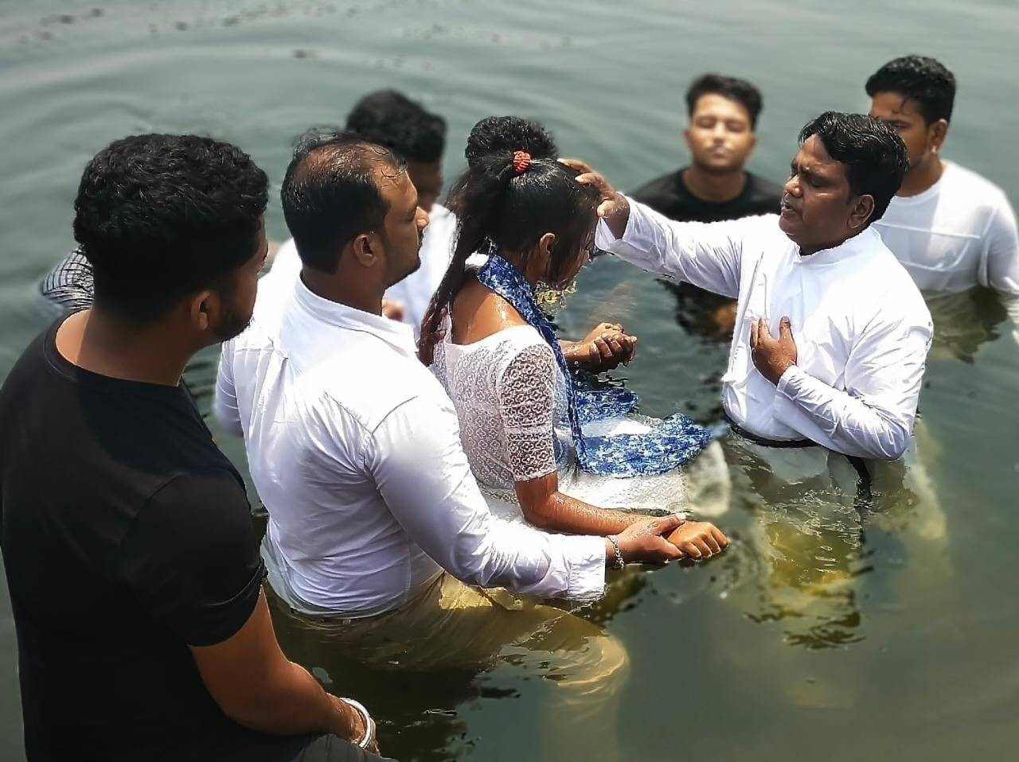

Peter:
From
Failed Disciple
To
Faithful Witness

Slide 2
Week 4: Bearing Witness to People Who Are Suffering
1 Peter 4:7-19
I often question God as to why He would allow bad things to happen to me. So, for quite too long, I have been maintaining such questions in my heart to an extent I thought God was being partial to me for allowing me to lose both parents. - Kadie

Slide 3
What does the Text Mean?
Week 4: Bearing Witness to People Who Are Suffering
1 Peter 4:7-19

Slide 4
What does the Text Mean?
Who Does the Text say We Should Be?
Week 4: Bearing Witness to People Who Are Suffering
1 Peter 4:7-19

Slide 5
What does the Text Mean?
Who Does the Text say We Should Be?
How Can We Put this Word of God into Action?
Week 4: Bearing Witness to People Who Are Suffering
1 Peter 4:7-19

Slide 6
Week 4: Bearing Witness to People Who Are Suffering
1 Peter 4:7-19
Before accepting Christ in my heart, I felt very sad because I have no father and my friends teased me about it. I felt that my life had no meaning in this world; my family took advantage of me.
- Antoine

Slide 7
Peter:
From
Failed Disciple
To
Faithful Witness

