Slide 1



Slide 2

Hole-y
Snacks

Slide 3
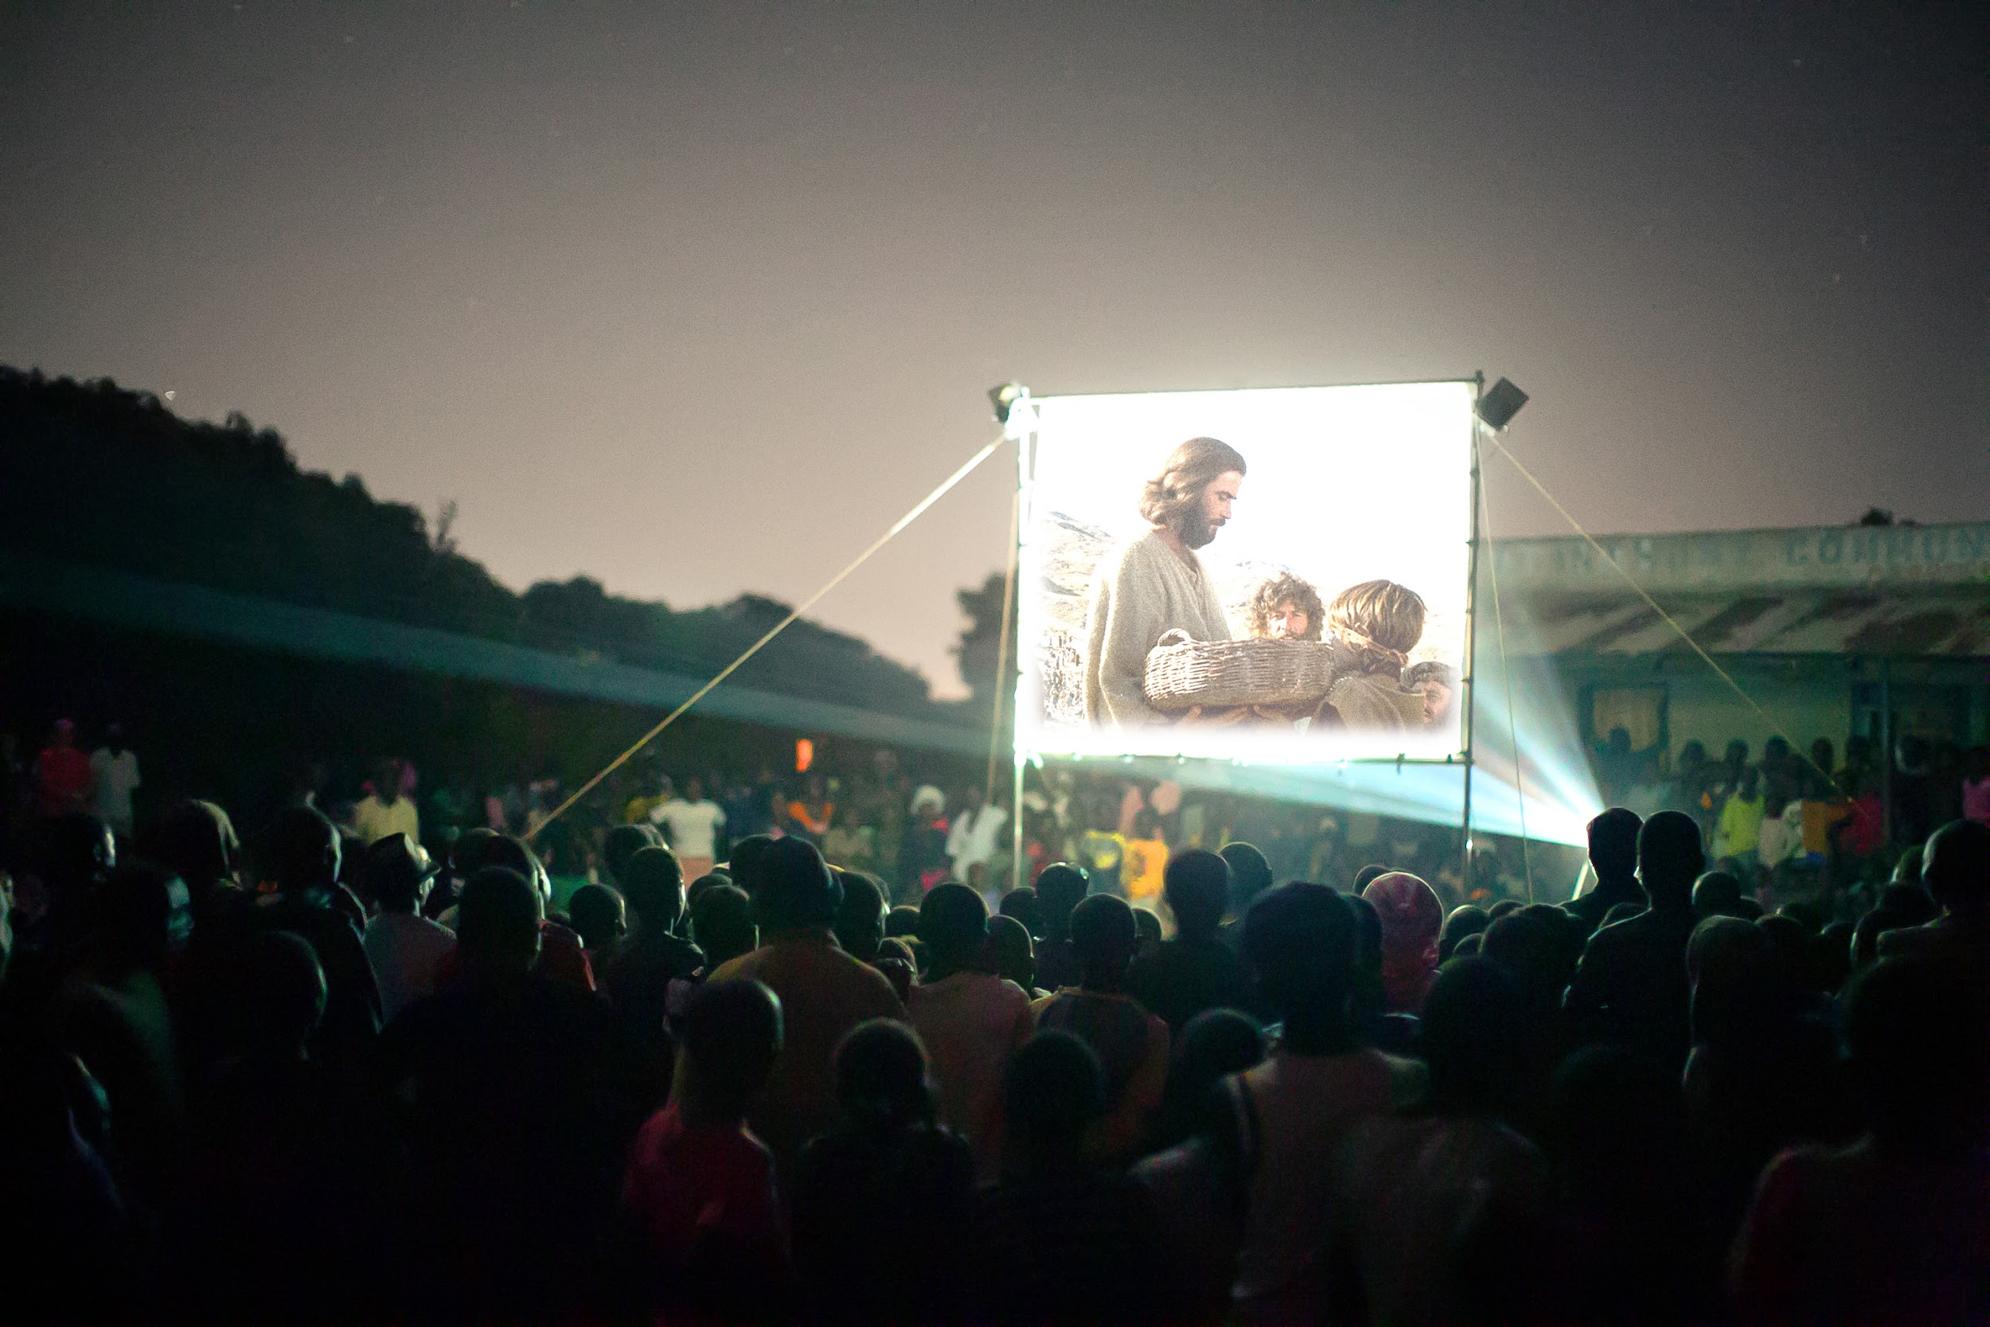

Welcome

Slide 4
Inhale: We Have
Exhale: seen the Lord

Slide 5
John 20:21 (NIV)
“Again Jesus said, ‘Peace be with you!
As the Father has sent me,
I am sending you.’”

Slide 6
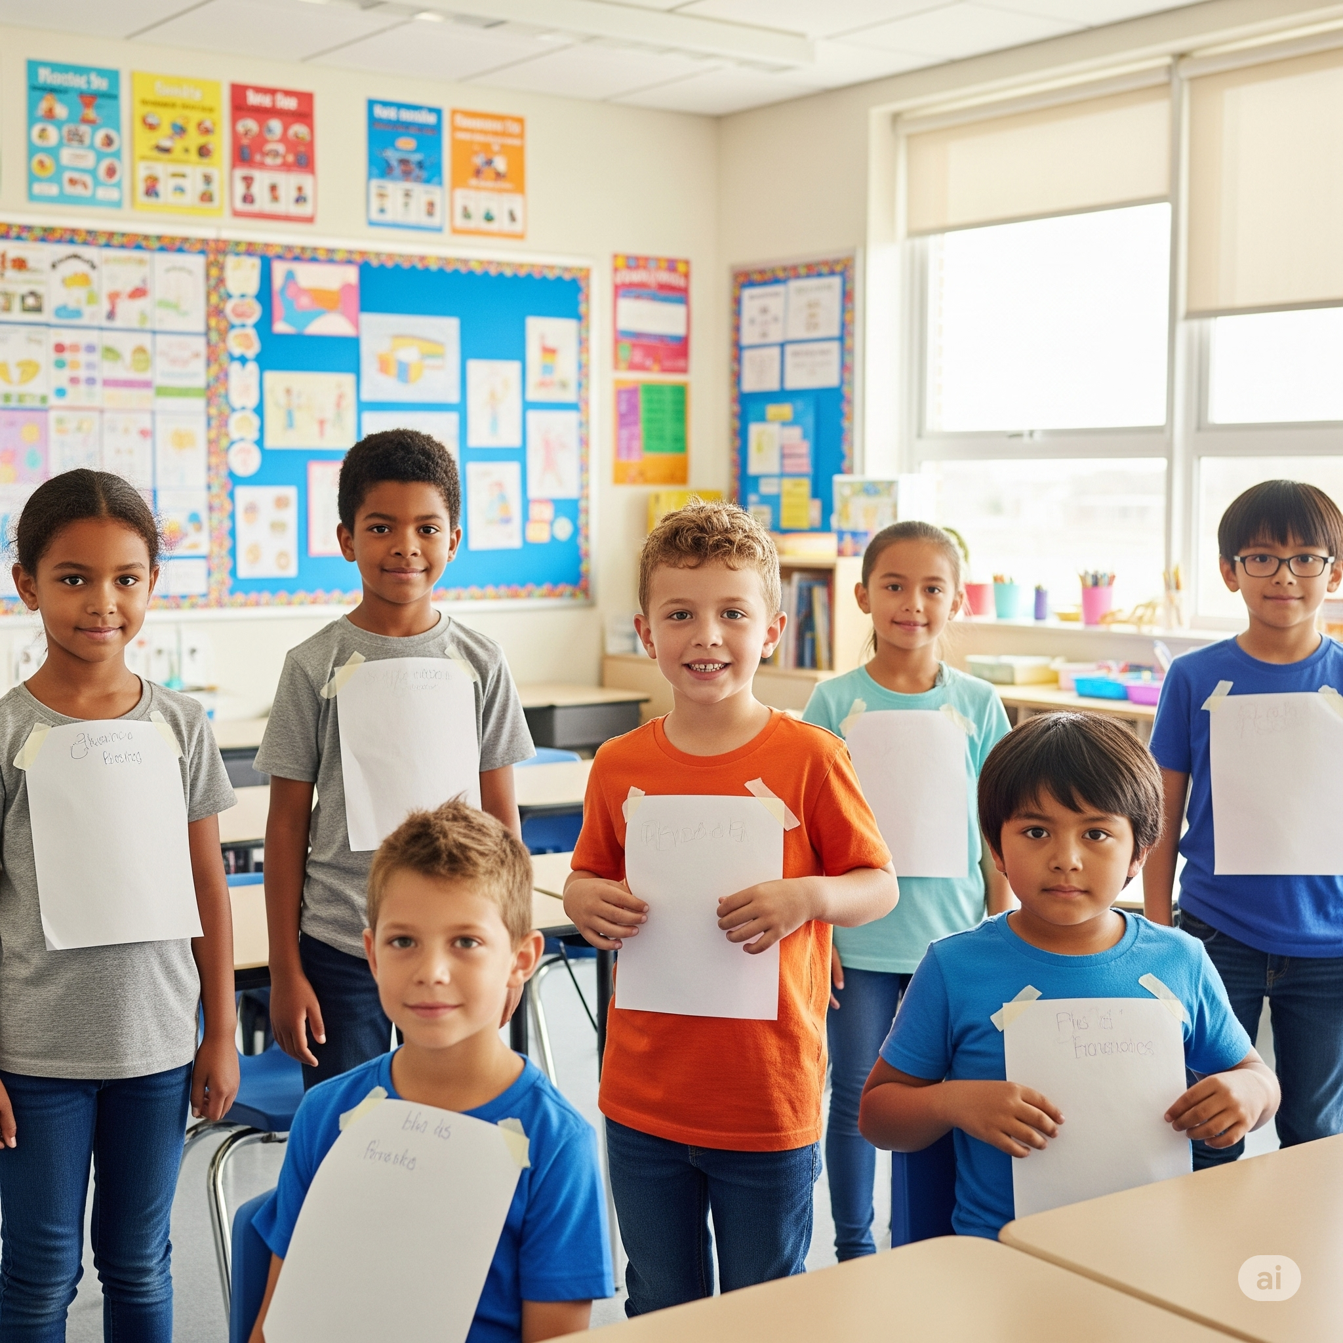

Slide 7
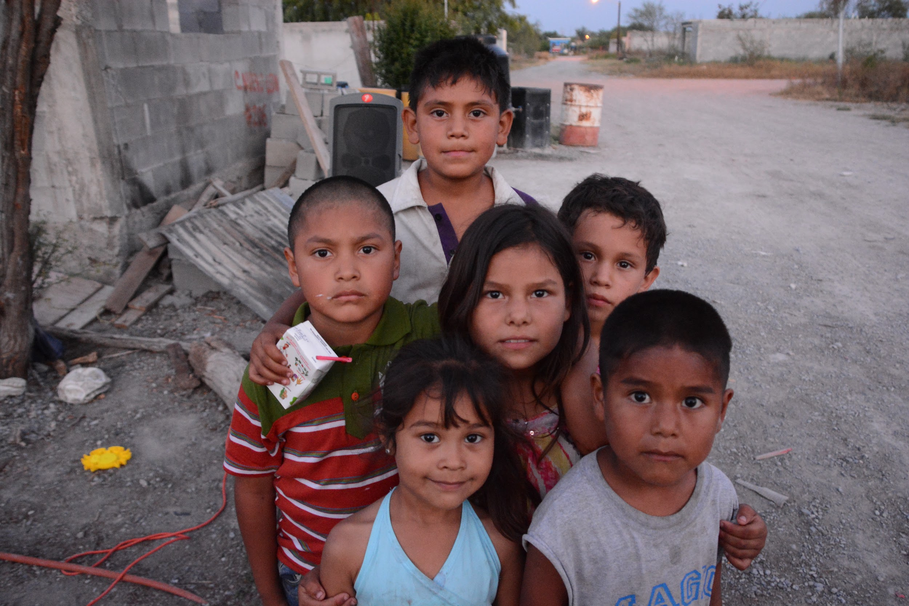
Tithes &
Offerings

Slide 8
Evidence
By Josh Baldwin

Slide 9
I Believe
By Phil Wickham

Slide 10
Prayer

Slide 11




Preschool
Elementary

Slide 12
John 20:24-31

Slide 13

Journal
Prompt
Today’s Date

Slide 14


Slide 15

4 Corners

