Slide 1
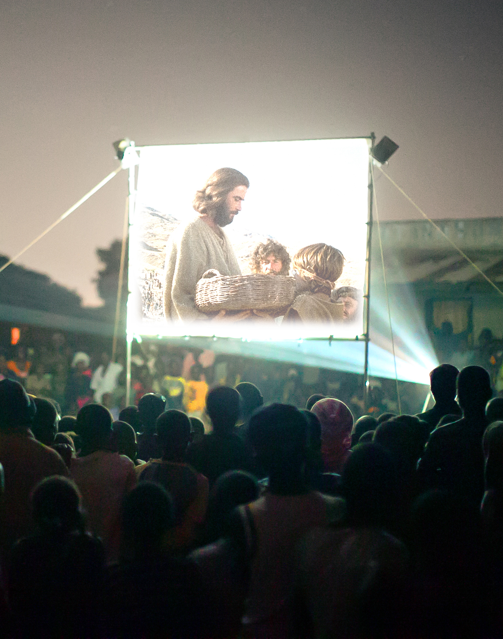

New Life in Jesus: The Disciples
From Afraid to Empowered

Slide 2

Bible
Lesson:
John 20:19-23

Slide 3
1. Jesus Brings Peace
Amid Our Fear

Slide 4
Jesus came and stood among them and said, “Peace be with you!” After he said this, he showed them his hands and side. The disciples were overjoyed when they saw the Lord.
John 20:19b-22

Slide 5
2. Jesus’ Peace comes with the Call to be
Sent as He was Sent

Slide 6
Jesus came and stood among them and said, “Peace be with you!” After he said this, he showed them his hands and side. The disciples were overjoyed when they saw the Lord.
Again Jesus said, “Peace be with you! As the Father has sent me, I am sending you.”
John 20:19b-22

Slide 7
3. If Christ Calls You,
He Will Equip You

Slide 8
Jesus came and stood among them and said, “Peace be with you!” After he said this, he showed them his hands and side. The disciples were overjoyed when they saw the Lord.
Again Jesus said, “Peace be with you! As the Father has sent me, I am sending you.” ²² And with that he breathed on them and said, “Receive the Holy Spirit.”
John 20:19b-22

Slide 9
New Life in Jesus: The Disciples
From Afraid to Empowered

