Slide 1
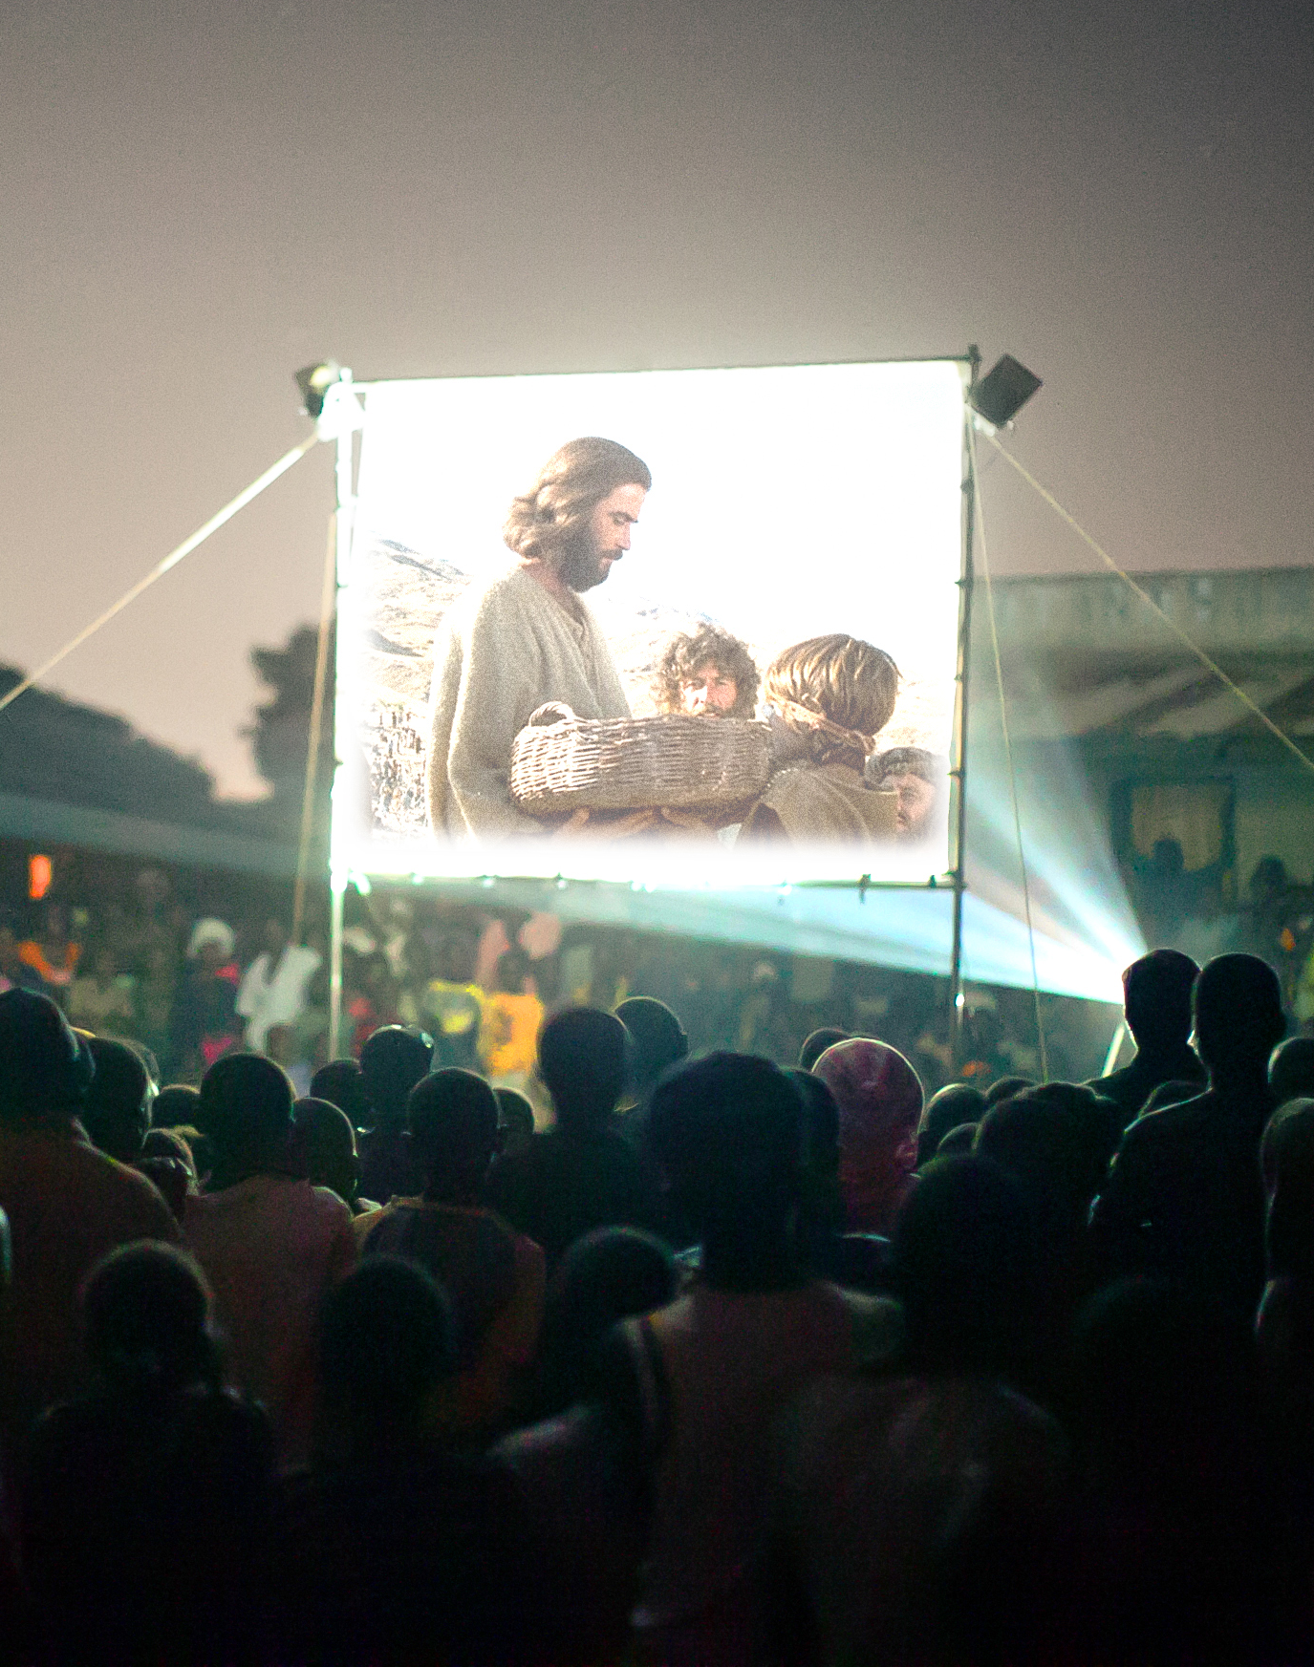

New Life in Jesus: Thomas
From Doubting to Declaring

Slide 2
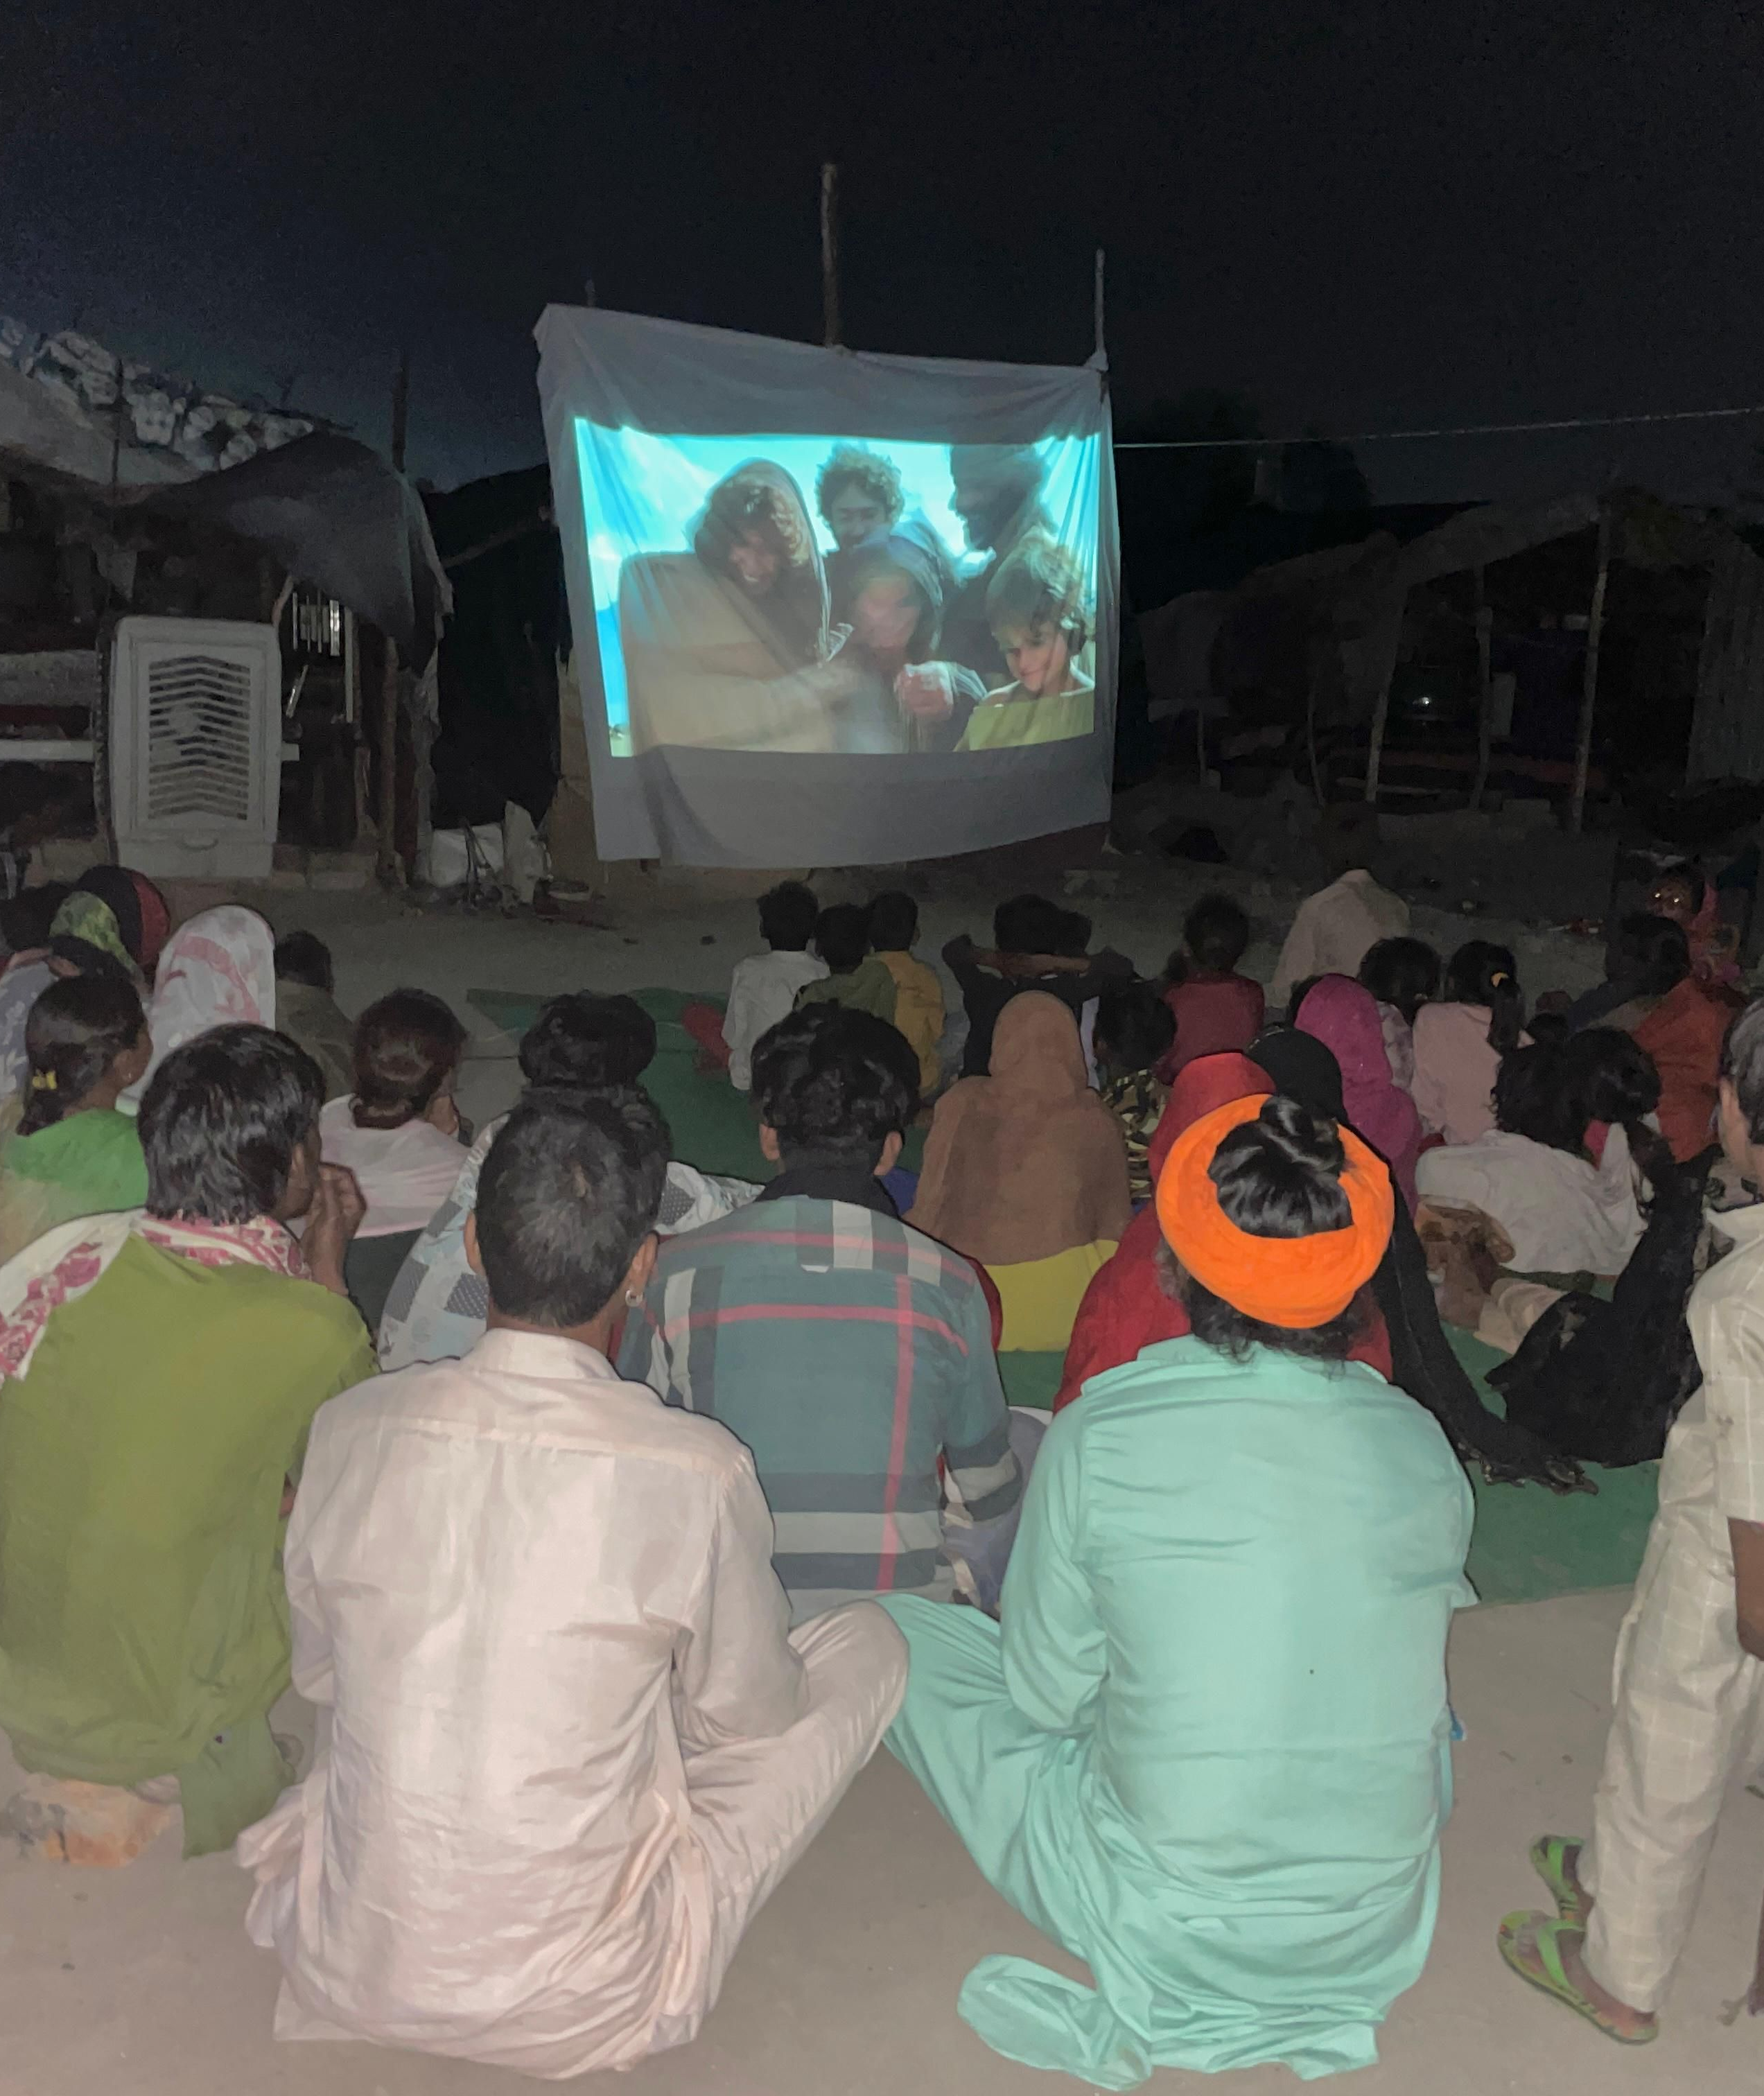
Bible
Lesson:
John 20:24-31

Slide 3
1. Jesus Meets Us IN
Our Doubt

Slide 4
“Put your finger here; see my hands. Reach out your hand and put it into my side. Stop doubting and believe.”
John 20:27

Slide 5
2. When Our Doubt is
Met with Jesus, It is
OVERCOME and We
DECLARE

Slide 6
“Put your finger here; see my hands. Reach out your hand and put it into my side. Stop doubting and believe.”
Thomas said to him, “My Lord and My God
John 20:27-28

Slide 7
New Life in Jesus: Thomas
From Doubting to Declaring

